Slide 1
Bridging the gap between complex sensor data and clinical knowledge
Haochang Shou, PhD
Assistant Professor of Biostatistics
December 1, 2020

Slide 2
Wearable computing sensor data
Wearable computing sensor data
are passively or actively collected from a class of measurement devices that attach to the human body
allow objective assessment of 'activity, bio signals, or environmental factors' in real time
high frequency data collection at free-living environment
signals collected repeatedly over days and weeks
Large scale cohort studies such as National Health and Nutrition Examination Survey (NHANES), UK Biobank, All Of US and the RURAL (Risk Underlying Rural Areas Longitudinal) Study are increasingly collecting various biosignals of study participants through various wearable computing sensors

Slide 3
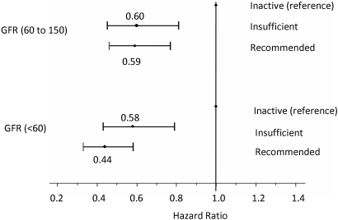
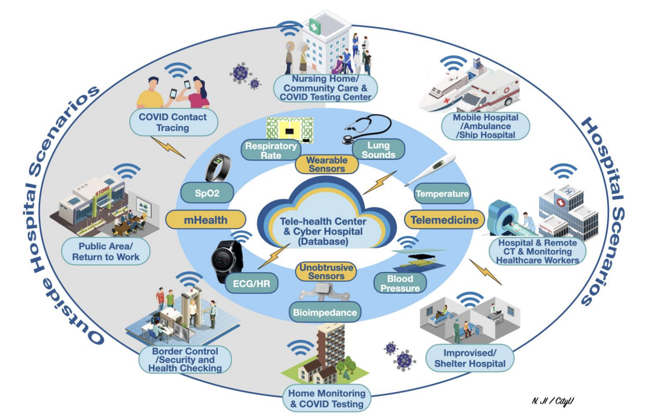
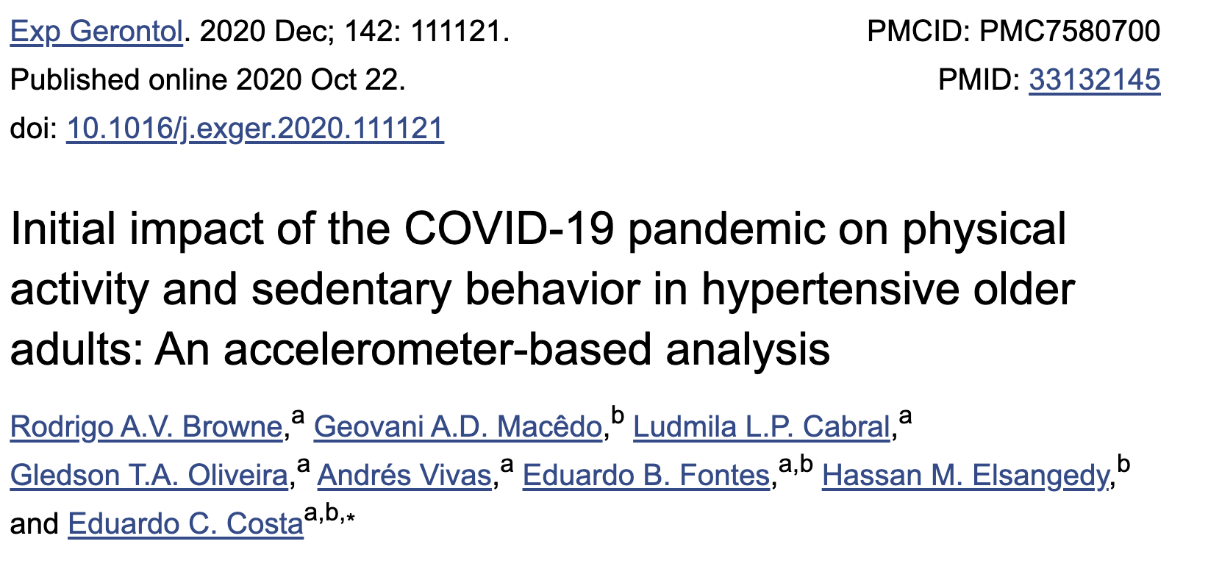
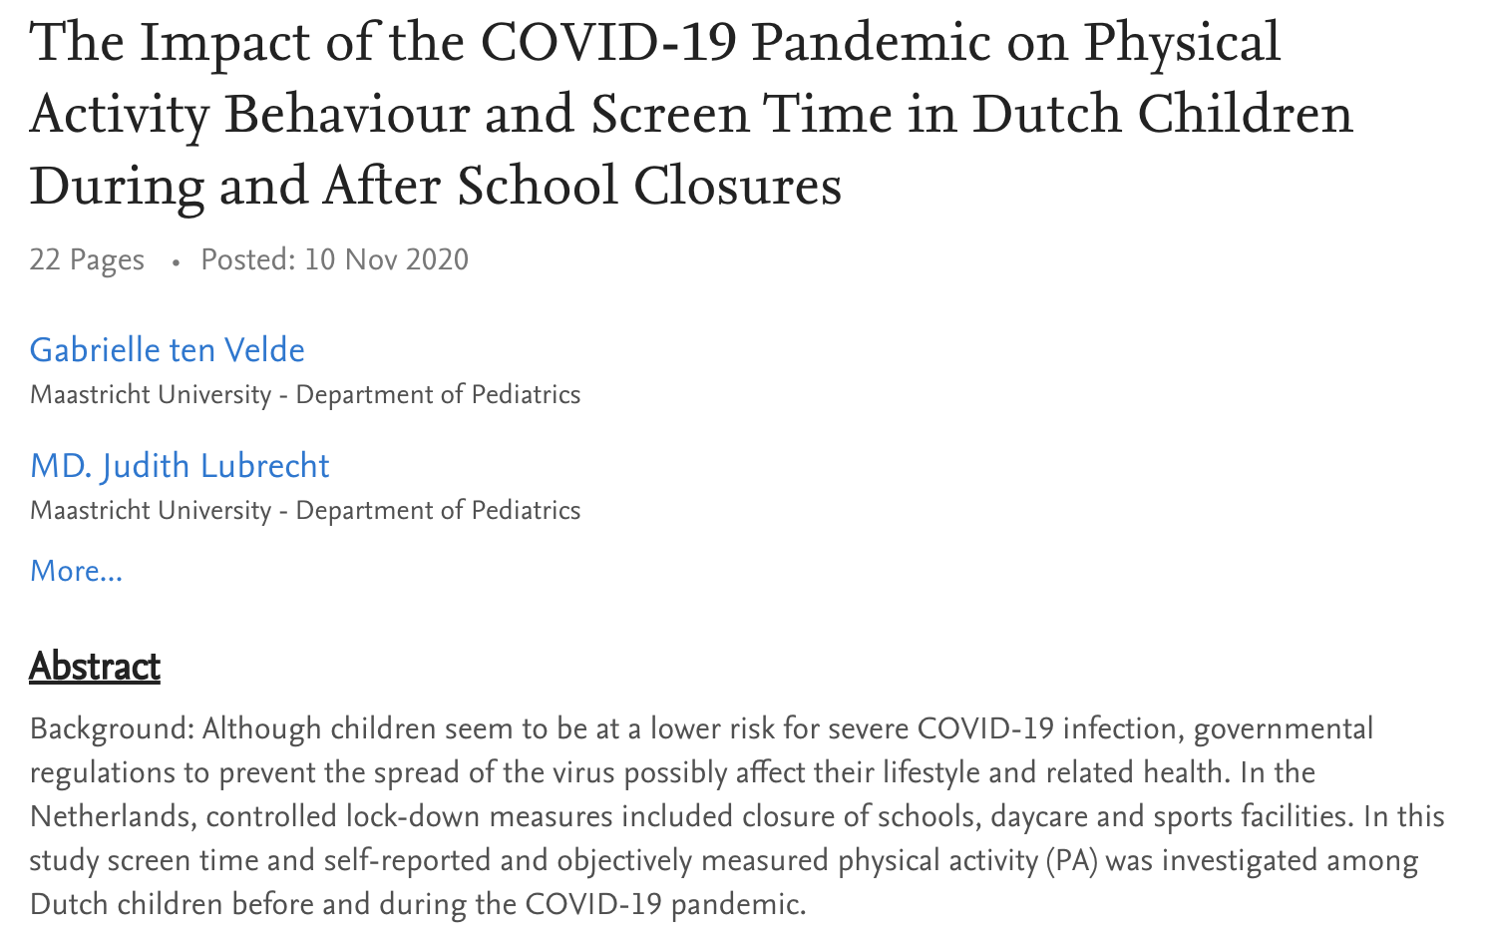
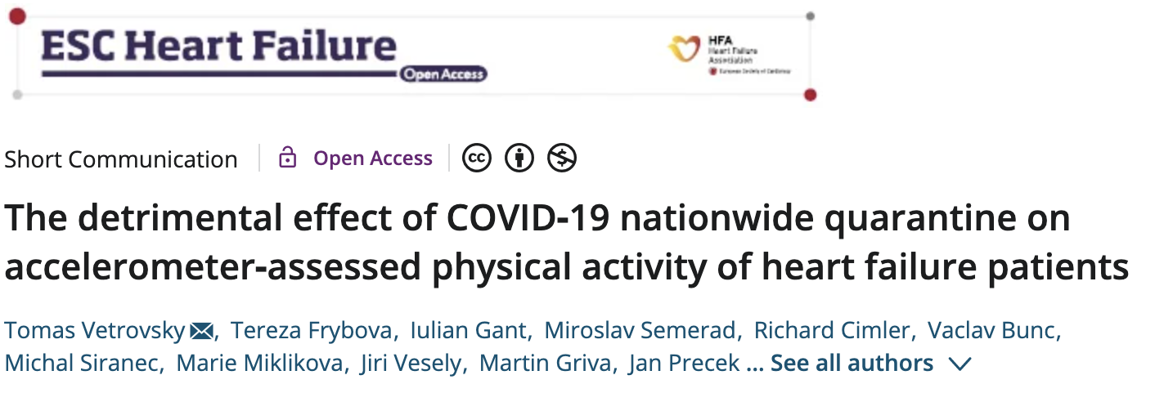
Physical activity and mobile health
Physical activity markers have been reported to be predictive of all cause mortality and associated with physical and mental health
Ekelund et al. (2019) BMJ
Beddhu et al. (2009) CJASN
mHealth during COVID-19 Pandemic
Ding et al. (2020) IEEE.

Slide 4
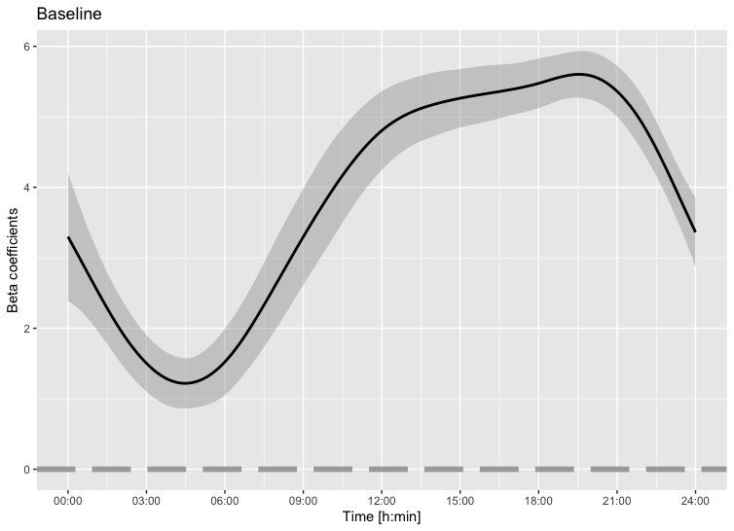
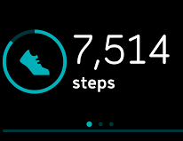
Gaps between device data and clinical markers
Despite the dense tracking of movement over time, conventional physical activity markers in clinical settings remain univariate summary of:
Total activity intensity (e.g. total log activity counts, counts per minute, step counts)
Discretized distributions: time spent in sedentary, light and moderate-to-vigorous physical activity (MVPA)
Reproducible findings of simple gross summary markers could be challenging due to lack of standardized unit and universal cut points that define activity categories across device types and population
What’s collected
What’s reported

Slide 5
Mmarch consortium
Motor Activity Research Consortium for Health (mMARCH)
A collaborative international network to facilitate the standardized protocols of procedures, analyses and data sharing among research groups collecting actigraphy data
Aims to investigates associations between motor activity, mood, and related disorders
6 participating core study sites include National Institutes of Health, Lausanne University Hospital, VU University Medical Center Amsterdam, Chinese University of Hong Kong, University of Sydney Brain and Mind Centre, and QIMR Berghofer Medical Research Institute.

Slide 6
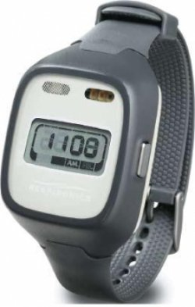
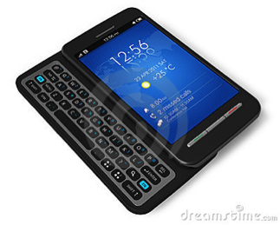
Sensor monitoring in NIMH family studies of spectrum disorders
NIMH family study of spectrum disorders is a community-based sample including 500 adult probands with type I and type II Bipolar Disorders, Major Depression (MDD) and others, as well as over 1500 first-degree relatives.
Accelerometry Data
~350 participants wearing Philips Respironics Actiwatch on non-dominant hands; additional 100+ participants with data from GENEActiv devices
minute-by-minute activity counts with 2 weeks of follow-up
4945 person-days; 7,120,800 data points
Ecological Momentary Assessment (EMA)
Survey questionnaire sent 4 times a day
Mood, activity, energy, reactivity, food intake, stress, physical health
1-7 Likert point scales
Kathleen R. Merikangas, PhD

Slide 7
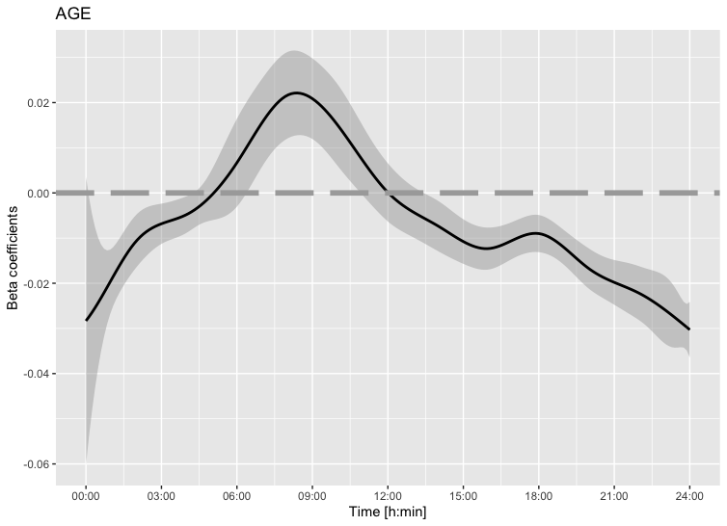
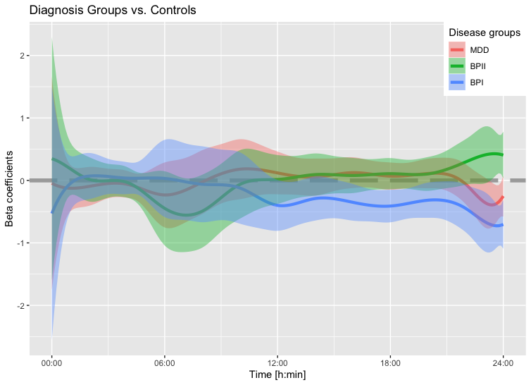
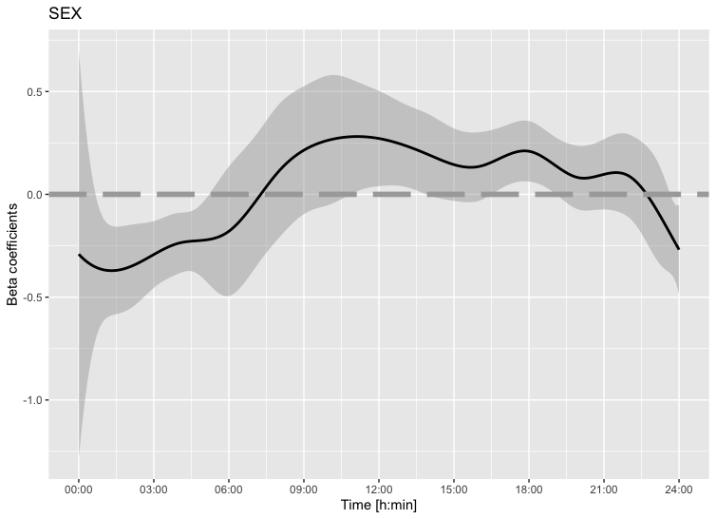
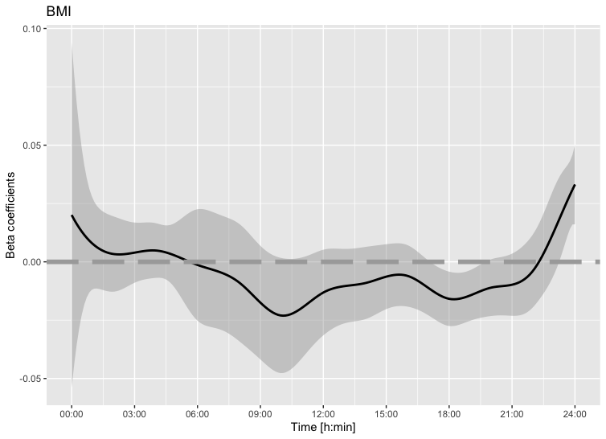
Time-varying mean Activity and mood
Function-on-scalar regression (FoSR) models the 24hr activity profiles as outcomes on subject-specific covariates indicating time-varying associations with age, sex and BMI. Subjects with BPI were observed to have lower mean activity intensities compared to others, after controlling for medication.
$${E[Y}_{id}\left(t, x_{i}\right)]= μ\left(t,x_{i}\right)=β_{0}\left(t\right)+\sum_{m=1}^{M}{β_{m}\left(t\right)x_{im}} , t=1,2,…,1440;d=1,2,…,14$$
Baseline
Age
Dx
Sex
BMI

Slide 8
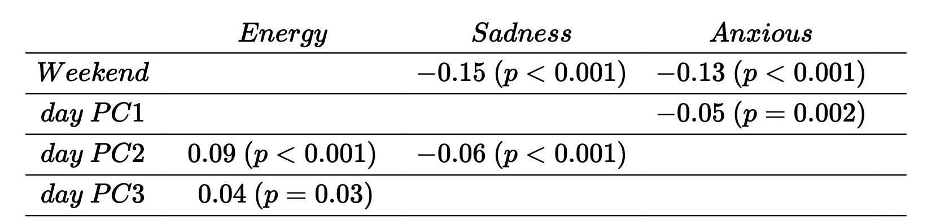
Concurrent Associations of Activity variability and Mood
Multilevel functional principal component analysis (MFPCA) to extract latent subject-specific and day-specific latent patterns in variability of activity.
$$Y_{id}\left(t, x_{i}\right)= μ\left(t,x_{i}\right)+U_{i}\left(t\right)+W_{id}\left(t\right)+e_{idt}$$
$= μ\left(t,x_{i}\right)+ \sum_{k=1}^{K}{ξ_{ik}ψ_{k}(t)}+$ $\sum_{l=1}^{L}{ε_{idl}φ_{l}(t)}+e_{idt}$
Shou et al. (2015). Structured functional principal component analysis. Biometrics, 71, 1:247-257
Shou et al (2020+). Beyond the Daily Averages: Respecting the Time of Day in Accelerometry-assessed Motor Activity via Functional Regression and Functional Principal Component Analysis Methods. Under review.

Slide 9
Dynamic Associations of Activity and Mood
Bidirectional associations were found between energy level ($β$= 0.027; P = .03) and motor activity ($β$ = 0.176; P = .03), and sleep duration ($β$= –0.154; P = .04) and motor activity ($β$= –0.027; P = .04).
A unidirectional association between motor activity and subsequent changes in mood ($β$= -0.018; P = .04)
Interaction was observed between Bipolar I disorder and sad mood level and subsequent sleep duration
Merikangas et al (2019). Real-time mobile monitoring of the dynamic associations among motor activity, energy, mood, and sleep in adults with bipolar disorder.
JAMA Psychiatry 76 (2), 190-198.

Slide 10
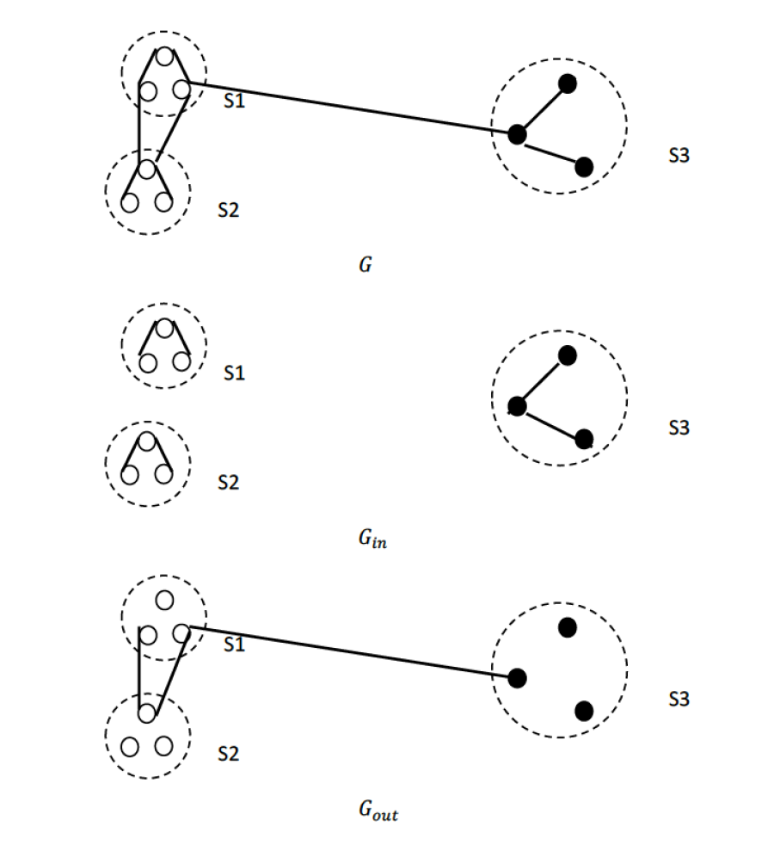
Activity profile as Continuous distributional object
Hongzhe Li, PhD
Jingru Zhang, PhD
Zhang et al. Two-sample tests for Repeated Measurements of Histogram Objects with Applications to
Wearable Computing Device Data. Under review.

Slide 11
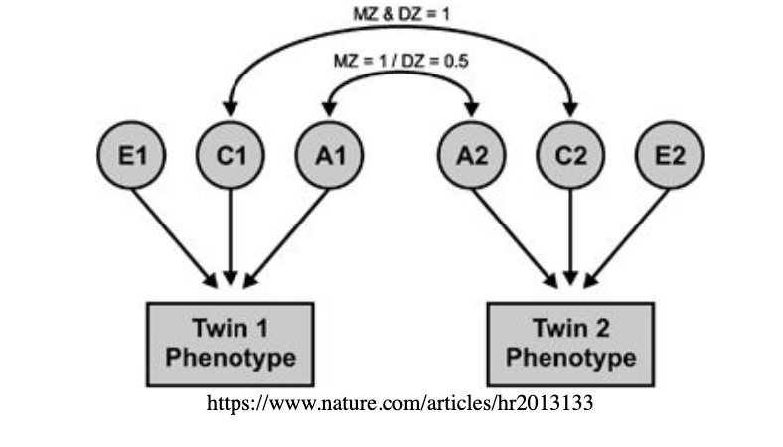
Heritability of activity traits in twin study
Adolescent Australian twins recruited from primary and secondary schools in the South East Queensland, by personal referrals, or via the Queensland Twin Registry conducted at the Queensland Institute of Medical Research (QIMR)
~200 pairs of MZ and DZ twins (41% MZ and 59% DZ) wore a wrist GENEActiv on the non-dominant wrist for two-week period after each visit
Traditional twin analyses separate phenotypical measures into latent components including additive genetic (A), common and unique environmental (C and E) effects, and estimate heritability as
$$h^{2}=\frac{σ_{A}^{2}}{σ_{A}^{2}+σ_{C}^{2}+σ_{E}^{2}}$$
Previous literature has reported traits with moderate heritability¹ (0.47 in MVPA, 0.31 sedentary) and with high heritability (>0.6) traits including mean activity during wake, total time in homothermic state during wake and restless duration²
Ian Hickie, PhD
¹den Hoed et al. (2013). Heritability of objectively assessed daily physical activity and sedentary behavior. Am J Clin Nutr, 98, 5:1317-25.
²Gehrman PR et al (2019). Twin-based heritability of actimetry traits. Genes Brain Behav, 18, 5:e12569.

Slide 12
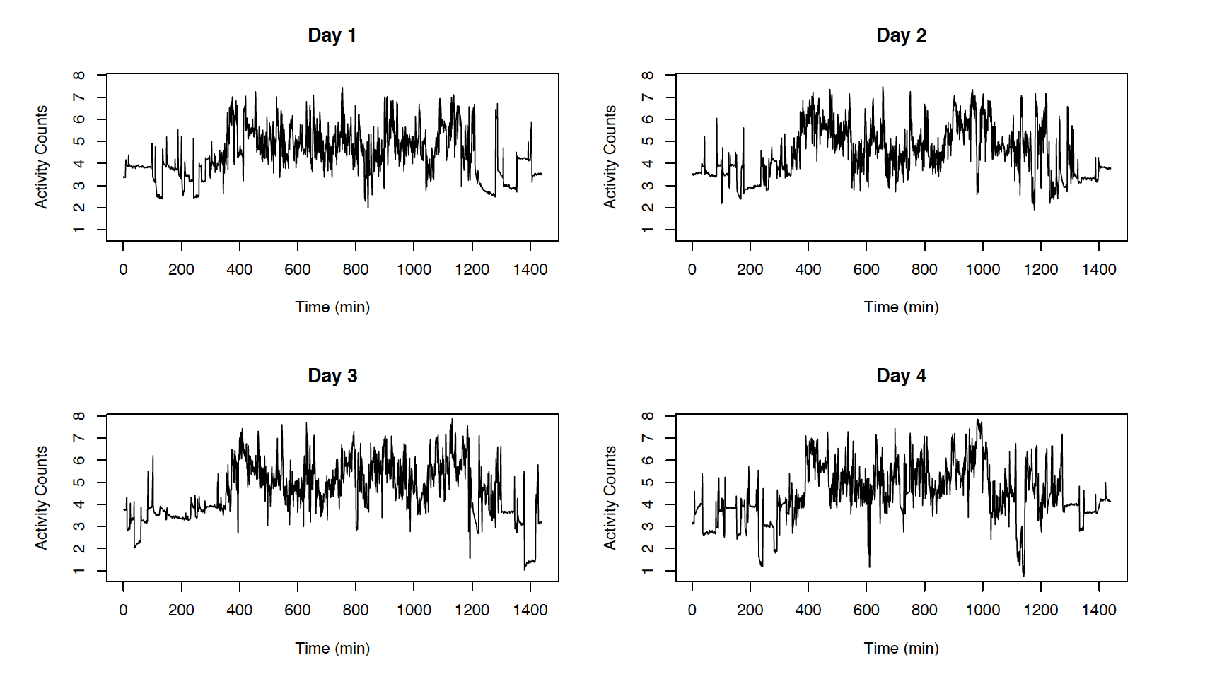
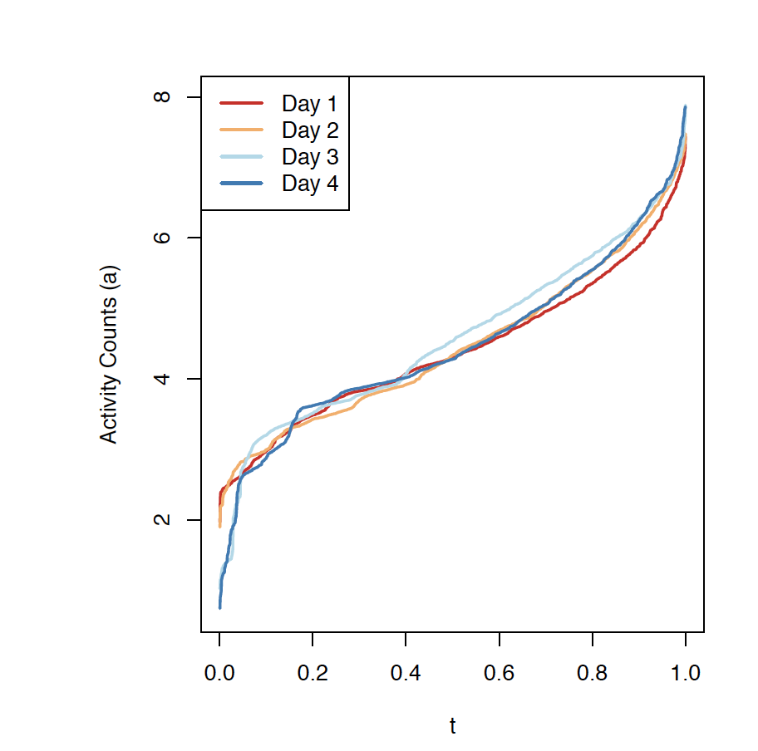
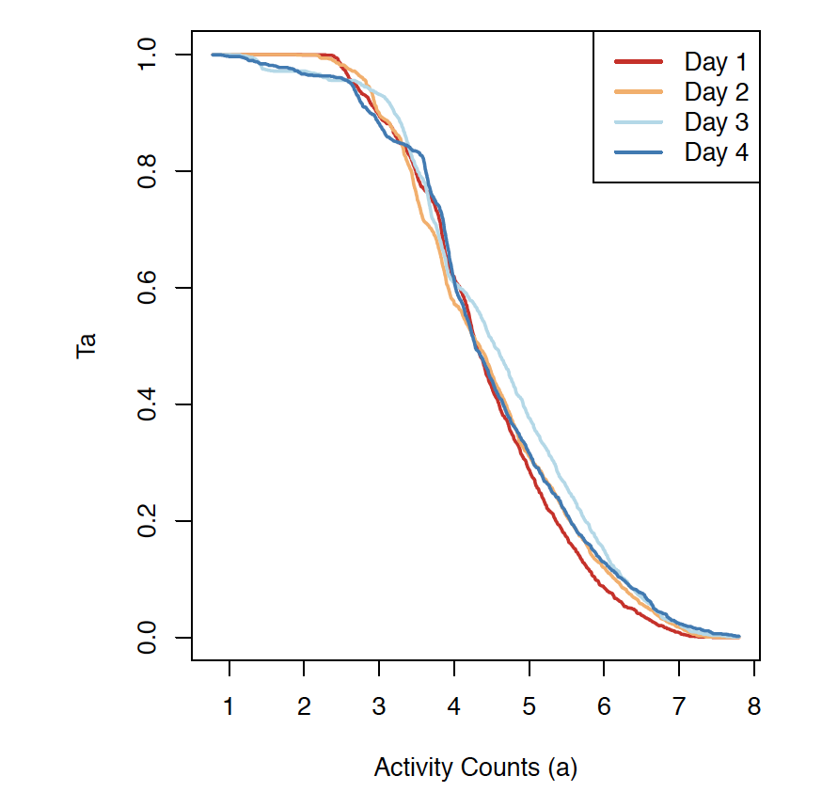
Multiple views of daily activity distribution
Subjects’ log-transformed daily activity intensities $Y_{id}\left(t\right),,t=1,2,…,1440$ were transformed into
repeated quantile functions $Q_{id}\left(p\right)=inf\left\{a∈ℛ, p≤F_{Y}\left(a\right)\right\}, p∈\left[0, 1\right];$
activity profiles $T_{id}\left(a\right)=Lebesgue\left(\left\{t∈\left[0, T\right]:Y_{id}\left(t\right)≥a\right\}\right)/T$as the percentage of time spent above activity intensity $a$.
Quantile function Q(p)
Activity profile T(a)
p
a
¹Ian Mckeague. https://www.ima.umn.edu/materials/2019-2020/DW9.16-17.19/28237/

Slide 13
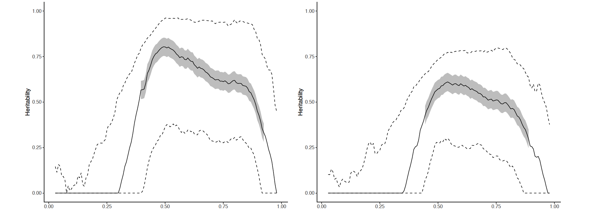
Variance components model to detect heritable traits in activity distributions
Heritability of activity profiles T(a)
Mixed-effects type variance component models for distributional object data with repeated measures and developed Empirical likelihood approach to estimate and test for variance components. For twin pair from family f, subject i on day d,
$$T_{fid}\left(a\right)=x_{fij}β\left(a\right)+A_{fi}\left(a\right)+C_{f}\left(a\right)+E_{fi}\left(a\right)+U_{fid}\left(a\right)+e_{fida}$$
where $A_{fi}\left(a\right)=\left\{I_{MZ}+{\sqrt{0.5}I}_{DZ}\right\}g_{f}\left(a\right)+\sqrt{0.5}g_{fi}\left(a\right)$
Ranges of activity intensities identified data-driven cut points to define heritable activity traits.
Repeated Measures
Subject-average
a
a
Heritability of Quantiles Q(p)
Repeated Measures
Subject-average
p
p
Zhang et al. Heritability Inference on Repeated Measures of Wearable Device Data. In preparation.

Slide 14
More gaps to fill for practical use of device data
Harmonization across device types and studies
Prediction modeling based on multimodal sensor features
Jian Hu, MS
Danni Tu, MS
Wei Guo, PhD

Slide 15
Summary
Wearable computing sensor data provide tremendous opportunity to observe and understand the complex signals related with biological functionalities and human behavior in unprecedented details
Identification of reproducible markers across devices and study populations remain challenging and require careful study design and analyses
Novel statistical methods are needed that engage guidance from clinical knowledge to extract deep phenotypic metrics from wearable computing sensor data
http://gph.is/1fJCMo0

Slide 16
References
Lee, IM, Shiroma, EJ (2014). Using accelerometers to measure physical activity in large-scale epidemiological studies: issues and challenges. Br J Sports Med, 48, 3:197-201.
Shou H et al. (2017). Dysregulation of objectively assessed 24-hour motor activity patterns as a potential marker for bipolar I disorder: results of a community-based family study. Transl Psychiatry, 7, 8:e1211.
Shou H et al (2015). "Structured functional principal component analysis". In: Biometrics 71.1, pp. 247-257.
Shou H et a. (2017). Dysregulation of objectively assessed 24-hour motor activity patterns as a potential marker for bipolar I disorder: results of a community-based family study. Translational Psychiatry 7(e1211).
U. Ekelund, et al. “Dose-response associations between accelerometry measured physical activity and sedentary time and all cause mortality: systematic review and harmonised meta-analysis”. BMJ (2019), 366:l4570.
Merikangas KR et al (2019)."Real-time Mobile Monitoring of the Dynamic Associations Among Motor Activity, Energy, Mood, and Sleep in Adults With Bipolar Disorder". In: JAMA Psychiatry
Gehrman PR et al (2019). Twin-based heritability of actimetry traits. Genes Brain Behav, 18, 5:e12569.
den Hoed et al. (2013). Heritability of objectively assessed daily physical activity and sedentary behavior. Am J Clin Nutr, 98, 5:1317-25.
Yang, H et al. (2020). Quantile Function on Scalar Regression Analysis for Distributional Data. J Am Stat Assoc, 115, 529:90-106.
Murray G et al (2020). Measuring circadian function in bipolar disorders: Empirical and conceptual review of physiological, actigraphic, and self-report approaches. Bipolar Disord, 22, 7:693-710.

Slide 17
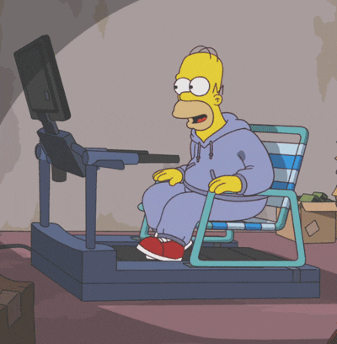
Acknowledgements
Dr. Kathleen Merikangas, Genetic Epidemiology Research Branch, National Institute of Health
Dr. Ian Hickie, University of Sydney Brain and Mind Centre
Dr. Nick Martin, QIMR Berghofer Medical Research Institute
Dr. Hongzhe Li, Center for Statistics in Big Data (CSBD)
Dr. Vadim Zipunnikov, Johns Hopkins WIT Group
This research was supported by NIMH Intergovernmental Personnel Act (IPA)
Keep Active and Stay Positive!
http://gph.is/1ks3Ca1
Thank you for listening!
📧 hshou@pennmedicine.upenn.edu

